Slide 1
Flight Price Prediction
Promila

Slide 2
OVERVIEW
1. Data Cleaning
2. Exploratory Data Analysis
3. Data Pre-processing
4. Model Building
5.Model Evaluation
6. Selecting the best model

Slide 3
Data Cleaning
1.Airline ticket can be bought up to 1 year advance Price Changes from day to day
2.Construct and train a general classifier so that it can distinguish between expensive and cheap tickets
3.Determine which factor have the greatest impact on price by analyzing the trained classifier

Slide 4
EDA
•Lots of Fields:
•“Buy Date : when was this price current?
•“Fly Date : when does the flight leave?
•Price and currency
•Cabin class
•Booking class
•The “Airline” : the airline selling the ticket

Slide 5
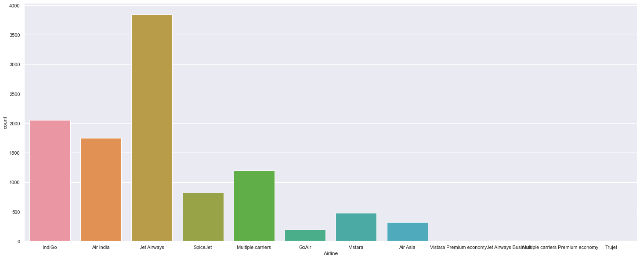

Slide 6
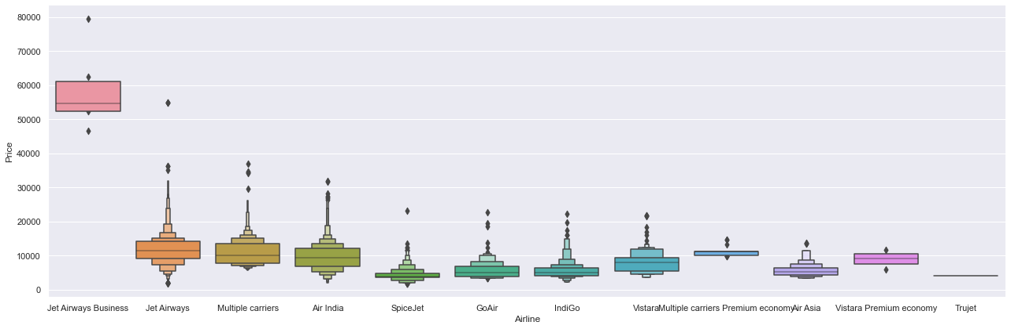

Slide 7
Detecting Multicollinearity with VIF
feature VIF
0 Total_Stops 6.140181
1 Journey_day 3.412960
2 Journey_month 13.545735
3 Dep_hour 5.589636
4 Dep_min 2.713153
5 Arrival_hour 4.834557
6 Arrival_min 3.324426
7 Duration_hours 6.192459
8 Duration_mins 3.855595
9 Airline_Air India 4.402039
10 Airline_GoAir 1.359039
11 Airline_IndiGo 4.141121
12 Airline_Jet Airways 8.071890
13 Airline_Jet Airways Business 1.008757
14 Airline_Multiple carriers 3.070824
15 Airline_Multiple carriers Premium economy 1.020174
16 Airline_SpiceJet 2.246288
17 Airline_Trujet 1.001439
18 Airline_Vistara 1.866831
19 Airline_Vistara Premium economy 1.003476
In [104]:

Slide 8
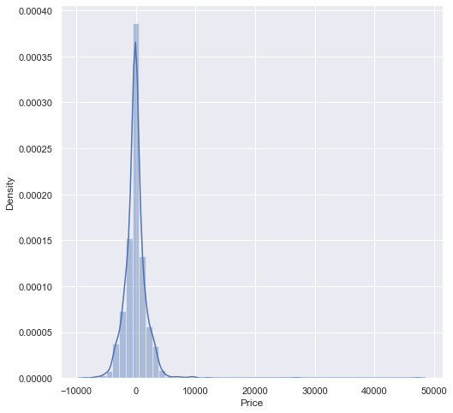
Model Building

Slide 9
from sklearn.ensemble import RandomForestRegressor
reg_rf = RandomForestRegressor()
reg_rf.fit(X_train, y_train)
Out[104]:
RandomForestRegressor()
In [105]:
y_pred = reg_rf.predict(X_test)
reg_rf.score(X_train, y_train)
Out[105]:
0.9528337535311826
In [106]:
reg_rf.score(X_test, y_test)
Out[106]:
0.7795030057803674

Slide 10
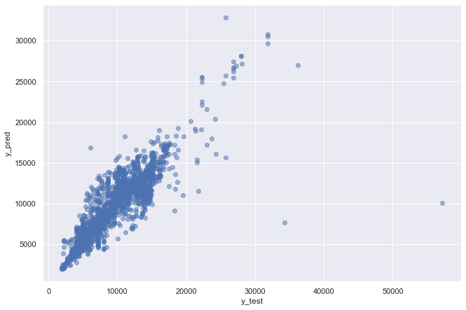

Slide 11
MACHINE LEARNING ALGORITHM
To develop the model for the flight price prediction, many conventional machine learning algorithms are evaluated. They are as follows: Linear regression, ExtraTreesRegressor, RandomForestRegressor, RandomizedSearchCV, GradientBoostingRegressor. All these models are implemented in the scikit learn. To evaluate the performance of this model, certain parameters are considered. They are as follows: R-squared value, Mean Absolute Error (MAE) and Mean Squared Error (MSE).

Slide 12
Saving The Model
import pickle
# open a file, where you ant to store the data
file = open('flight_rf.pkl', 'wb')
# dump information to that file
pickle.dump(reg_rf, file)

Slide 13
Thank You

